Slide 1

ECEN 482: Project 2
By Spencer Latimer

Slide 2

The Problem
I want an antenna to communicate with satellites and the like
Omnidirectional
C-band Frequency Range (4-8 GHz)
Low gain/directivity
-10dB S11 in C-band

Slide 3
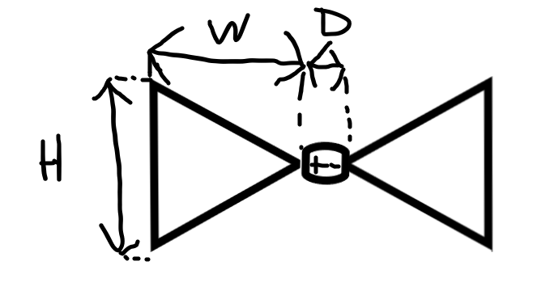
Bowtie Antenna
λ= 50mm
W = .375 λ
H = .25λ
D = .02066λ

Slide 4
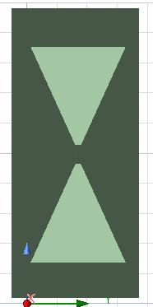
My Design
Y-Z Plane
W = 16.5 mm
D = 3 mm (so 36 mm total length)
H = 16 mm
Substrate: Rogers RO3203 (e = 3.02 Permittivity)
Substrate Depth = .6 mm
Metal: Copper

Slide 5
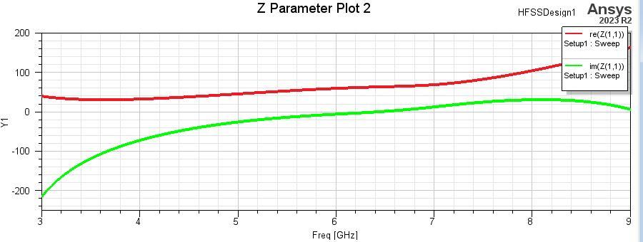
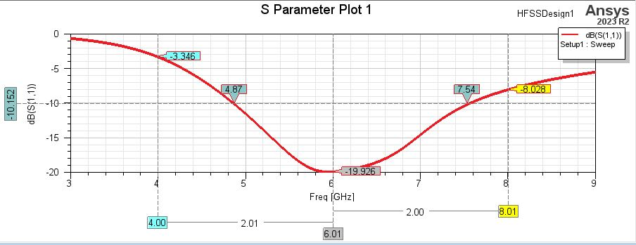
S11 and Z-Parameters and Input Impedance
Center Frequency S11: -20 dB
Not quite big enough bandwidth
As bandwidth increased, max directivity and gain (and directivity and gain in general) decreased up to a point
Real impedance was around 50
Shows Bow-tie preference for higher frequencies

Slide 6
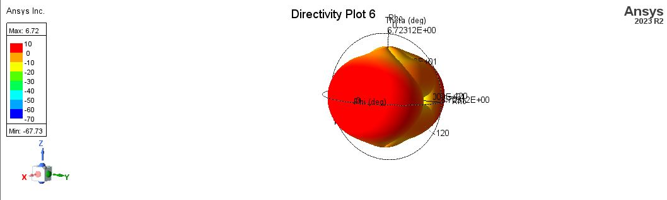
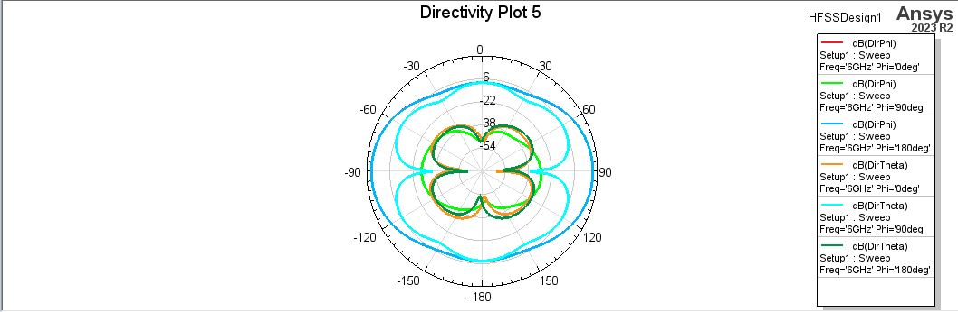
Directivity Plots
Max Directivity: 6.72dB
Looked to average around 4.8 dB
Everywhere but Broadside direction

Slide 7
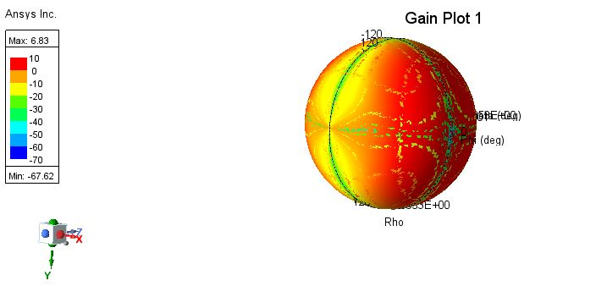
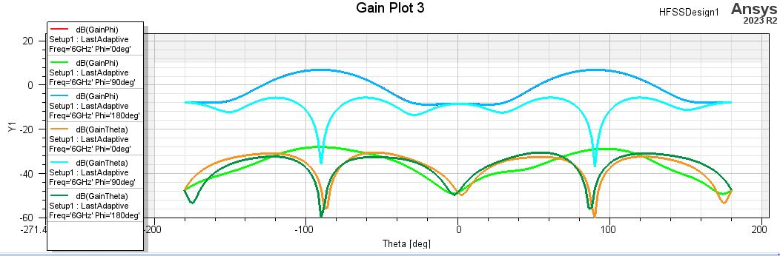
Polarization Graphs
Max Gain: 6.83
Gain everywhere but broadsided direction (same as directivity)

Slide 8
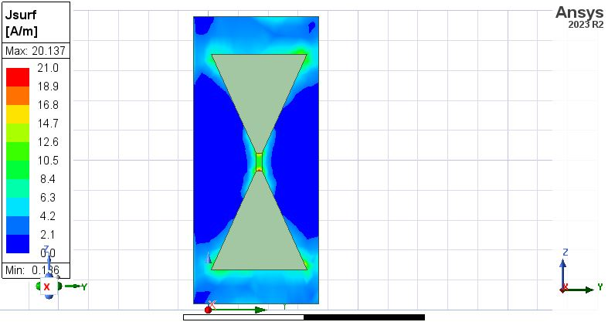
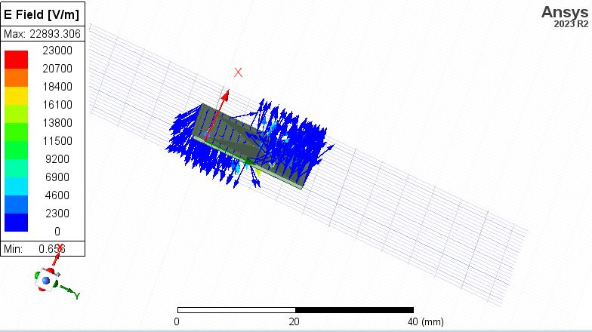
Current And E-Field Plot
Electric Fields coming out of sides of antenna rather than top/bottom (like dipole)
Current magnitude coming out of top and bottom

Slide 9
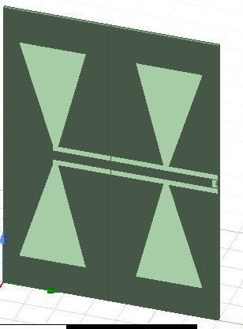
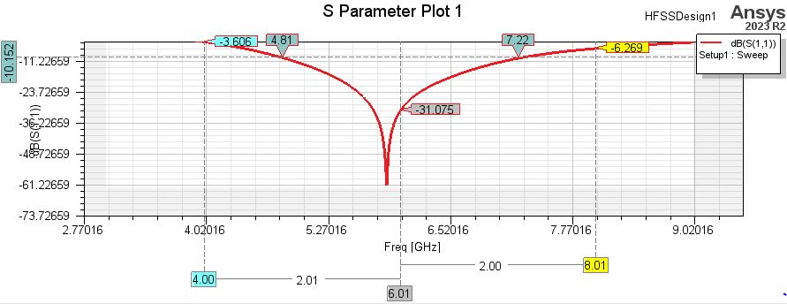
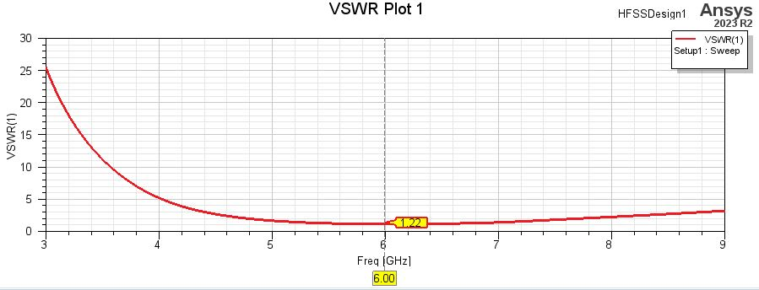
Weird Data and other attempts
Array of Bow-tie antennas top-left
-60dB S Parameter plot in the middle
VSWR plot on the right (1.22 at 6 GHz)

Slide 10
Results and Discussion
Overall had a bandwidth of around 2.7 GHz
Peak directivity/gain of 6.72/6.8 dB
Omnidirectional everywhere but broadside direction
With an array of bow-tie antennas, could accomplish higher directivity/gain
Other omnidirectional antennas could have been created (such as log-periodic or spiral antennas)

